Slide 1

Mealcraft control : Your gateway to balanced living
Here is where our presentation gonna begins

Slide 2
PILLARS OF TEAM Devadarshan K 192224040 Reddy Prasad B 192119023 Girish kumar B 192210500
9

Slide 3
INTRODUCTION
In the fast-paced world we live in today, maintaining a healthy and balanced lifestyle can be a challenge. Dietary choices play a crucial role in our overall well-being, impacting our physical health, mental clarity, and energy levels. Recognizing the significance of a well-balanced diet, we introduce "MealCraft" – an innovative project designed to empower individuals in taking control of their gateway to balanced living through strategic meal planning.
Metalcraft and Livelihood Enterprise Development of the University of Northern Philippines was implemented through its Extension Services Office focused on trainings to farmers, out-ofschool youth, and adults in rural communities in the province of Ilocos Sur, to enhance their creativity and skills in metal craft production.

Slide 4
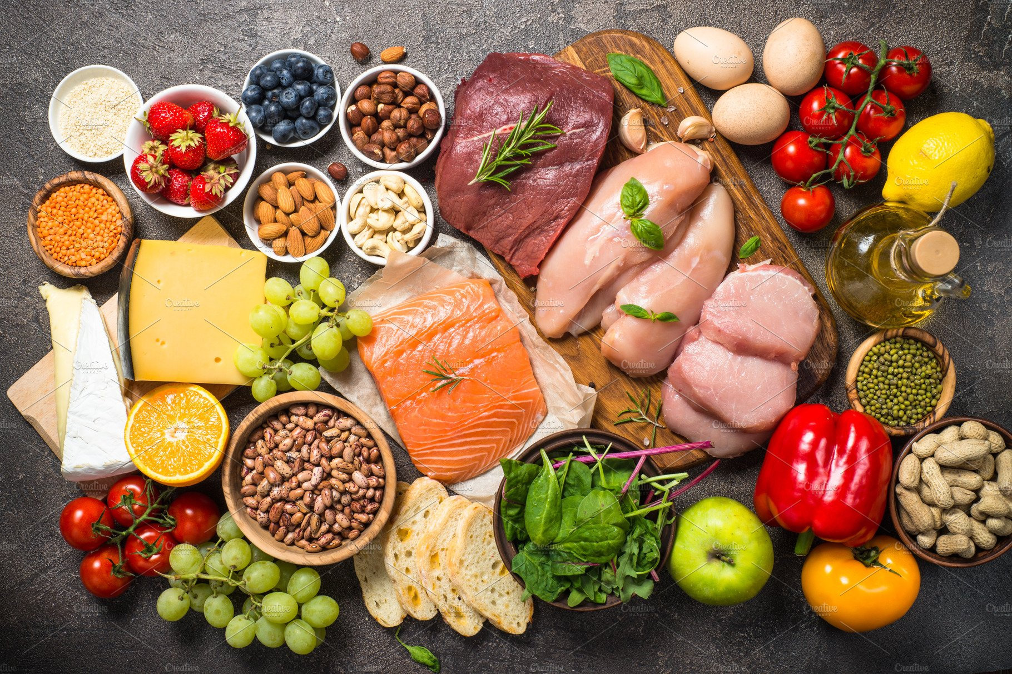
Abstract :
“MetalCraft - A Gateway to Balanced Living" is a Python-based project that integrates meal planning, nutrition tracking, and exercise recommendations to empower users in their journey towards a healthier lifestyle. Through a user-friendly interface, the project offers personalized meal plans, tracks nutritional intake, suggests exercise routines, and fosters a supportive community for shared success. The abstract encapsulates the essence of the project, combining technology with health and wellness.

Slide 5
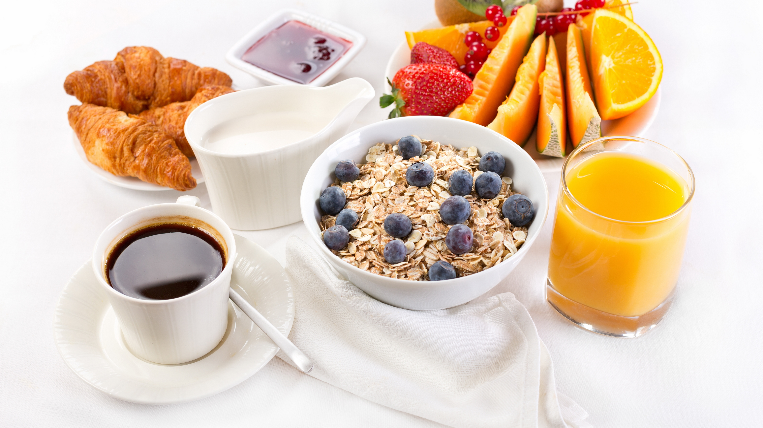
Awesome words

Slide 6
"Came from a plant, eat it; was made in a plant, don't."
– Michael Pollan, author and journalist.
“It is health that is real wealth and not pieces of gold and silver.”
– Mahatma Gandhi, lawyer and anti-colonial nationalis

Slide 7
Primary Objectives: # Personalized Meal Planning: Generate personalized meal plans based on user preferences, dietary requirements, and health goals. # Nutrition Tracking: Enable users to log their daily food consumption, providing detailed nutritional information for each meal. # Exercise Recommendations: Suggest exercise routines tailored to users' fitness levels, preferences, and health objectives. # User Community: Foster a supportive community where users can share their experiences, recipes, and success stories.

Slide 8
Secondary Objectives
#Profile Management:
Allow users to create and manage profiles, including personal information, dietary preferences, and fitness goals.
#Recipe Database:
Develop a comprehensive recipe database categorized by type, cuisine, and dietary considerations.
#Reminders and Notifications:
Implement reminder features for meal times, workout sessions, and other health-related activities.

Slide 9
Advantages
Personalized Approach:
MetalCraft tailors its recommendations to individual user profiles, ensuring a personalized and effective health and wellness experience.
Comprehensive Tracking:
Users benefit from a holistic tracking system that covers meals, nutrition, and exercise, providing a comprehensive overview of their lifestyle.
Community Support:
The user community feature facilitates a supportive environment where individuals can share insights, recipes, and encouragement, enhancing motivation.
Disadvantges
Dependency on User Input:
The effectiveness of the system relies on accurate and consistent user input, and discrepancies may impact the accuracy of recommendations.
Initial Learning Curve:
Users may face a learning curve when first using the platform, as they need to understand how to navigate features and input data effectively.
Technological Barriers:
This project endeavors to bridge the gap between technology and well-being, offering users a gateway to a balanced and healthier lifestyle.

Slide 10
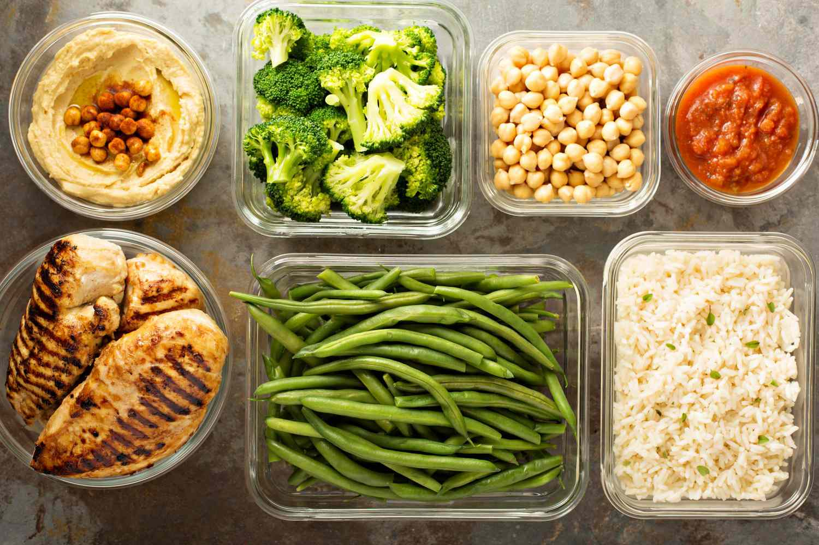
Privacy Maintance 1.Data Encryption 2.Anonymous Profiles 3.Minimal Data Collection 4.Explicit Consent 5.Transparent Privacy Policy 6.Data Anonymization 7.Secure Authentication 8.Regular Security Audits 9.User Control 10.Third-Party Services

Slide 11
Overview
"Welcome to our diet planning app, your personalized guide to achieving your health goals! Whether you're aiming to lose weight, build muscle, or simply adopt a healthier lifestyle, our app provides tailored meal plans and expert advice to support your journey. With intuitive features like customizable meal preferences, calorie tracking, and nutritional insights, staying on track has never been easier. Say goodbye to guesswork and hello to a happier, healthier you with our comprehensive diet planning app."

Slide 12
Conculsion:
Thank You
In conclusion, our diet planning app empowers you to take control of your health and nutrition with ease. By offering personalized meal plans, calorie tracking, and expert guidance, we're committed to helping you reach your wellness goals. Whether you're looking to shed a few pounds, bulk up, or simply improve your eating habits, our app is your trusted companion every step of the way. With convenience at your fingertips, embark on your journey towards a healthier lifestyle today.

